Slide 1
Types of Java Classes

Slide 2
Version Control and Revision History
 | Name | Date
Prepared By | Paranthaman
Reviewed By | Team
Approved By
Version No. | Date | Affected Sections | Highlights
1.0.0 |  | All | Based on the Course sheet Coverage

Slide 3








Iconic Representations.......
Test your Memory
Can you Solve?
Objective
Coffee Break
Queries
Recap
Need more Info
Brainstorm

Slide 4
Objective
Nested Classes
Notes:
It should be mentioned to the participant that current version of Java is 1.5, although not covered as part of this training.

Slide 5
Nested Classes
Class within another class
The scope of a nested class is bounded by the scope of its enclosing class
A nested class has access to the members, including private members, of the class in which it is nested. However, reverse is not true i.e. the enclosing class does not have access to the members of the nested class.
A nested class is also a member of its enclosing class.
As a member of its enclosing class, a nested class can be declared private, public, protected, or package private(default).
Nested classes should be used to reflect and enforce the relationship between two classes

Slide 6
Purpose of Nested Classes
They enable you to logically group classes that are only used in one place, thus this increases the use of encapsulation.
create more readable and maintainable code
Nested classes are of two types:
Static
Non-static aka Inner Class

Slide 7
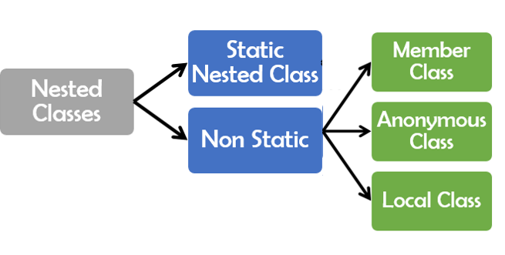
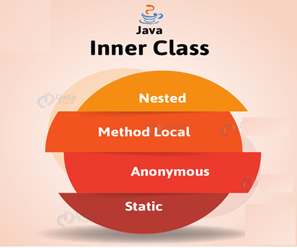
Type of Nested Classes

Slide 8
Type of Nested Classes
Type | Description
Member Inner Class | A class created within class and outside method.
Anonymous Inner Class | A class created for implementing interface or extending class. Its name is decided by the java compiler.
Local Inner Class | A class created within method.
Static Nested Class | A static class created within class.
Nested Interface | An interface created within class or interface.

Slide 9
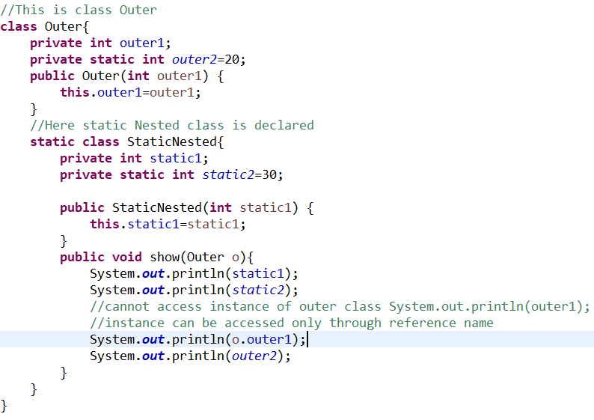

Coding Static Nested Class

Slide 10
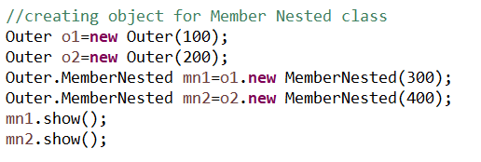
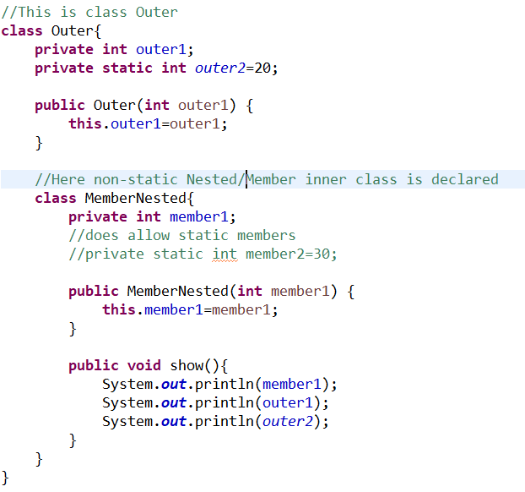
Coding Member Inner Class

Slide 11
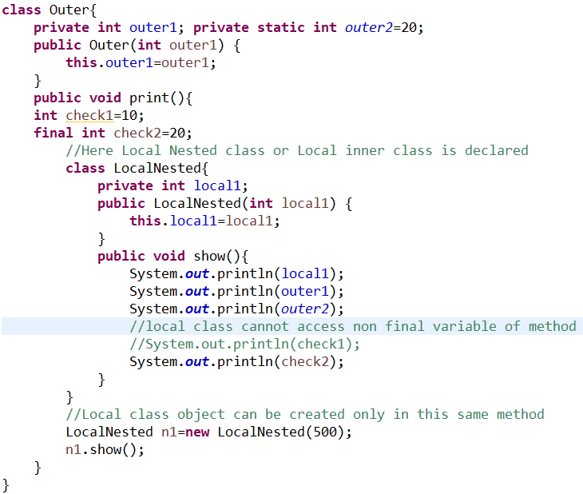
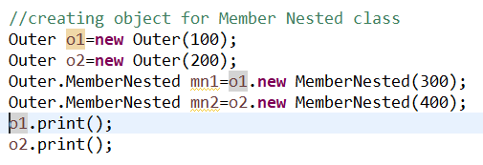
Coding Local Inner Class

Slide 12
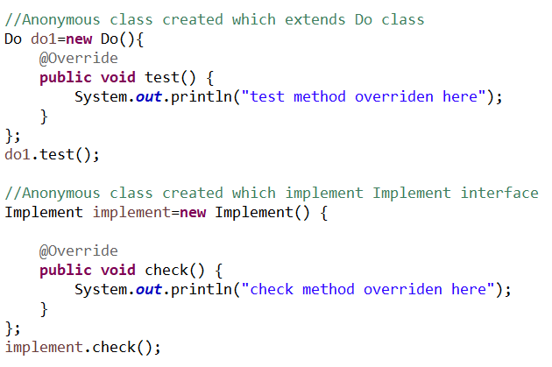
Coding Anonymous Inner Class

Slide 13
Enum
Enum in java is a data type that contains fixed set of constants.
Enums are used when we know all possible values at compile time, such as choices on a menu, rounding modes, command line flags, etc. It is not necessary that the set of constants in an enum type stay fixed for all time.
First line inside enum should be list of constants and then other things like methods, variables and constructor.
Every enum constant represents an object of type enum.
Every enum constant is always implicitly public static final. Since it is static, we can access it by using enum Name. Since it is final, we can’t create child enums.

Slide 14
Enum
Enum and Inheritance :
All enums implicitly extend java.lang.Enum class. As a class can only extend one parent in Java, so an enum cannot extend anything else.
toString() method is overridden in java.lang.Enum class,which returns enum constant name.
enum can implement many interfaces.
values(), ordinal() and valueOf() methods :
These methods are present inside java.lang.Enum.
values() method can be used to return all values present inside enum.
Order is important in enums.By using ordinal() method, each enum constant index can be found, just like array index.
valueOf() method returns the enum constant of the specified string value, if exists.
enum and constructor :
enum can contain constructor and it is executed separately for each enum constant at the time of enum class loading.
We can’t create enum objects explicitly and hence we can’t invoke enum constructor directly.
enum and methods :
enum can contain concrete methods only i.e. no any abstract method.

Slide 15
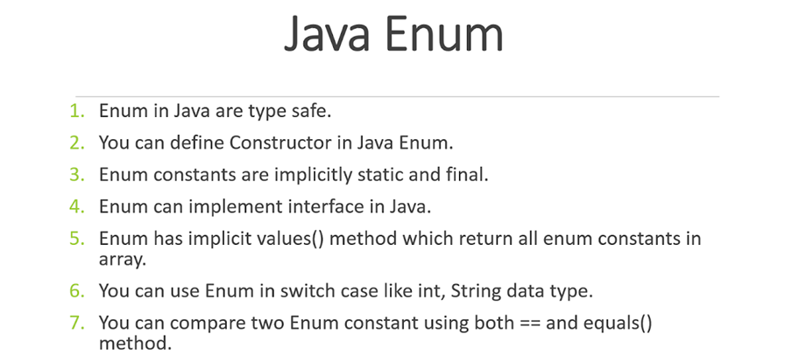
Enum

Slide 16
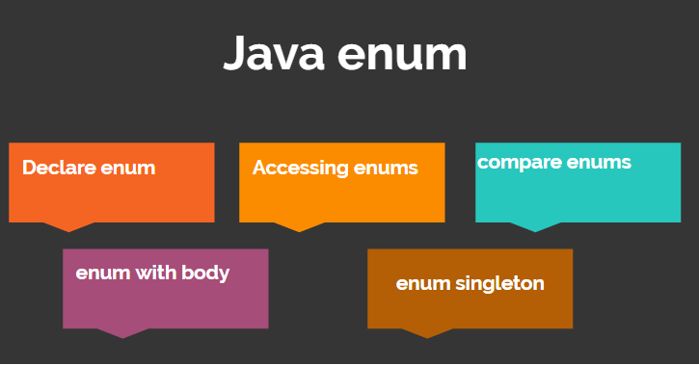
Enum

Slide 17
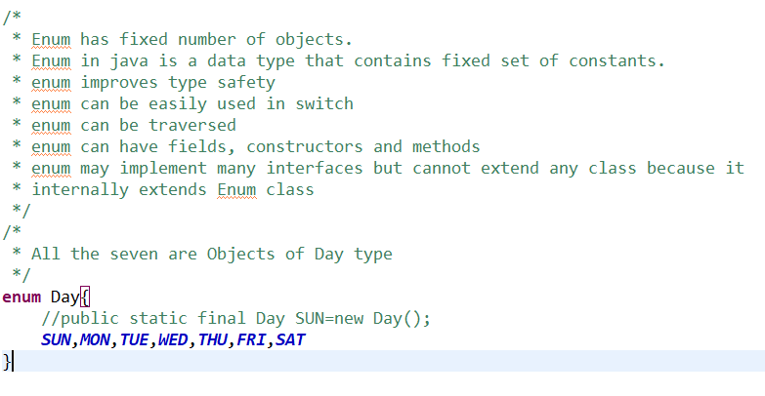
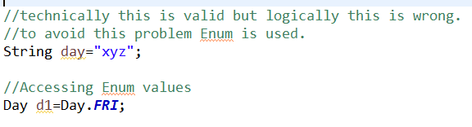
Coding Enum

Slide 18
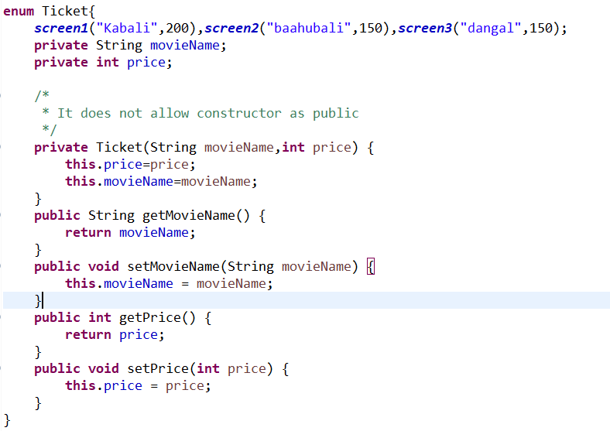
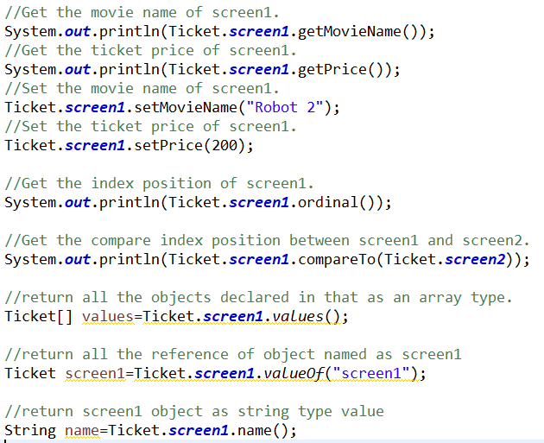
Coding Enum

Slide 19
Generics
Java Generic methods and generic classes enable programmers to specify, with a single method declaration, a set of related methods, or with a single class declaration, a set of related types, respectively.
Using Java Generic concept, we might write a generic method for sorting an array of objects, then invoke the generic method with Integer arrays, Double arrays, String arrays and so on, to sort the array elements.
Advantage of Java Generics
There are mainly 3 advantages of generics. They are as follows:
Type-safety : We can hold only a single type of objects in generics. It doesn’t allow to store other objects.
Type casting is not required: There is no need to typecast the object.
Compile-Time Checking: It is checked at compile time so problem will not occur at runtime. The good programming strategy says it is far better to handle the problem at compile time than runtime.

Slide 20
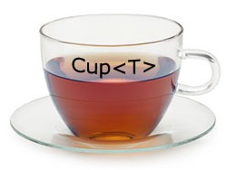
Generics

Slide 21
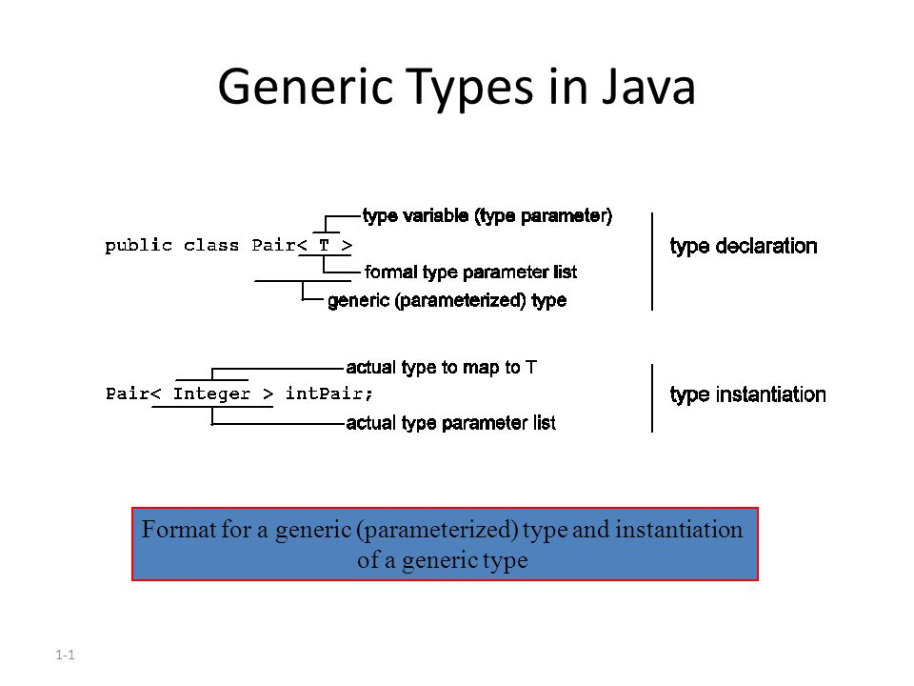
Generics

Slide 22
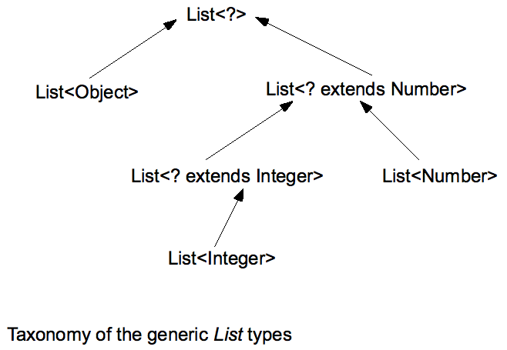
Generics

Slide 23
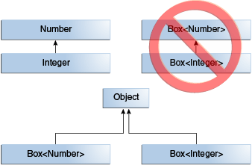
Generics

Slide 24
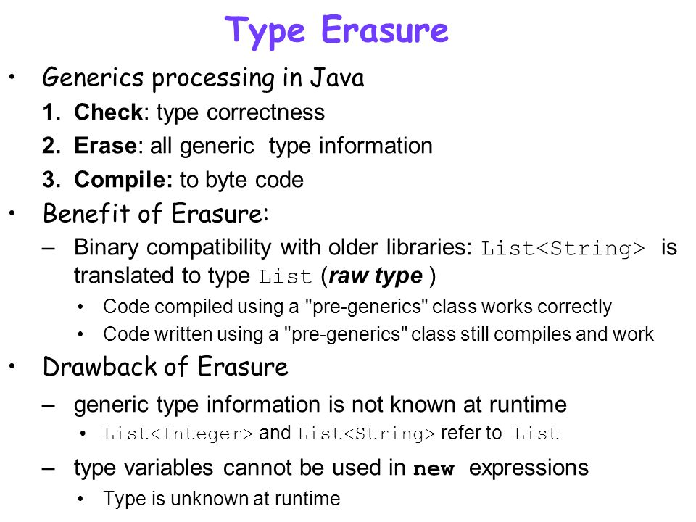
Generics

Slide 25
Generics
Java Generic methods and generic classes enable programmers to specify, with a single method declaration, a set of related methods, or with a single class declaration, a set of related types, respectively.
The Java Generics programming is introduced in J2SE 5 to deal with type-safe objects.
Before generics, we can store any type of objects in collection i.e. non-generic. Now generics, forces the java programmer to store specific type of objects.
Advantage of Java Generics
There are mainly 3 advantages of generics. They are as follows:
1) Type-safety : We can hold only a single type of objects in generics. It doesn’t allow to store other objects.
2) Type casting is not required: There is no need to typecast the object.
3) Compile-Time Checking: It is checked at compile time so problem will not occur at runtime. The good programming strategy says it is far better to handle the problem at compile time than runtime.

Slide 26
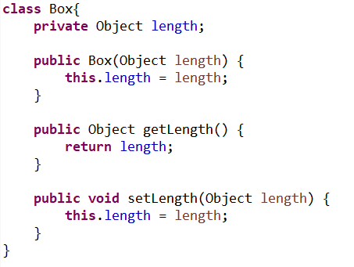
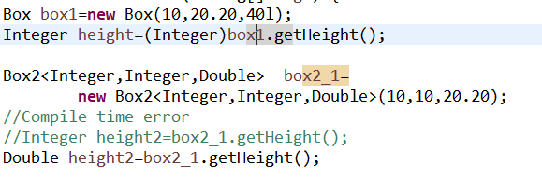
Before Generics

Slide 27
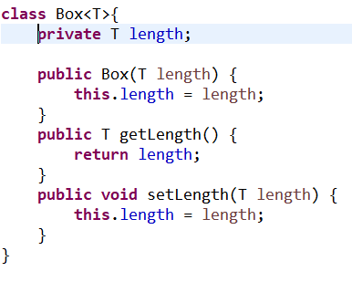

After Generics

Slide 28
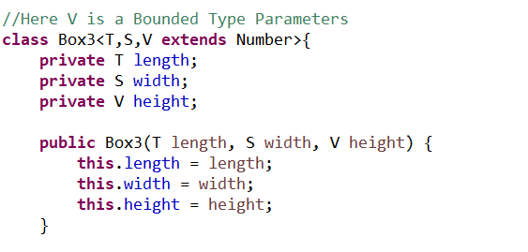
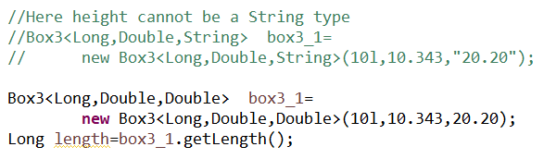
Multiple Generic types and Type Bounding

Slide 29

Annotations

Slide 30
Annotations
Annotations are used to provide supplement information about a program.
Annotations start with ‘@’.
Annotations do not change action of a compiled program.
Annotations help to associate metadata (information) to the program elements i.e. instance variables, constructors, methods, classes, etc.
Annotations are not pure comments as they can change the way a program is treated by compiler.
Built-In Java Annotations used in java code
@Override
@SuppressWarnings
@Deprecated
Built-In Java Annotations used in other annotations
@Target
@Retention
@Inherited
@Documente

Slide 31
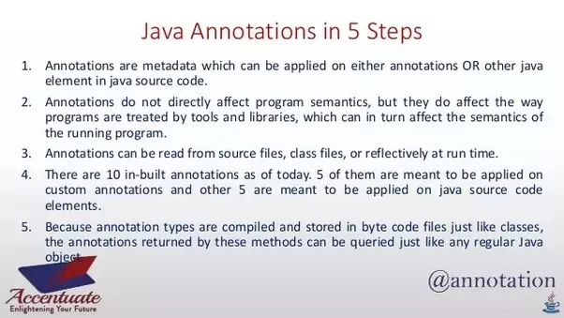
Annotations

Slide 32
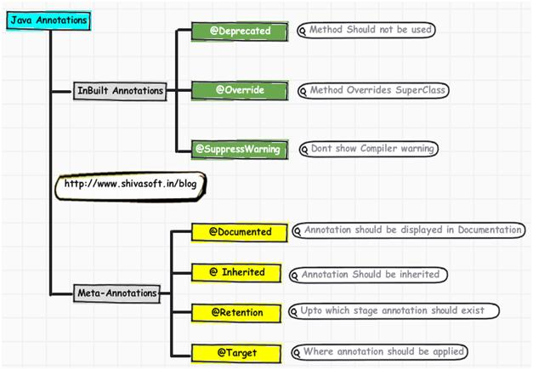
Annotations

Slide 33
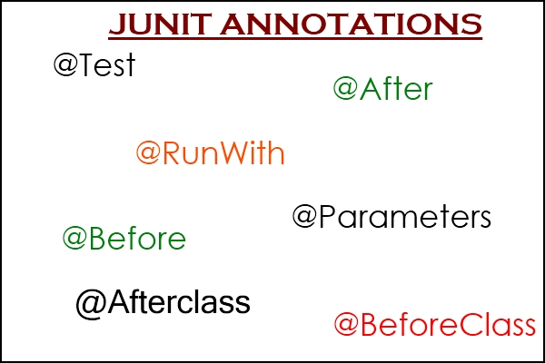
Annotations used in JUNIT

Slide 34
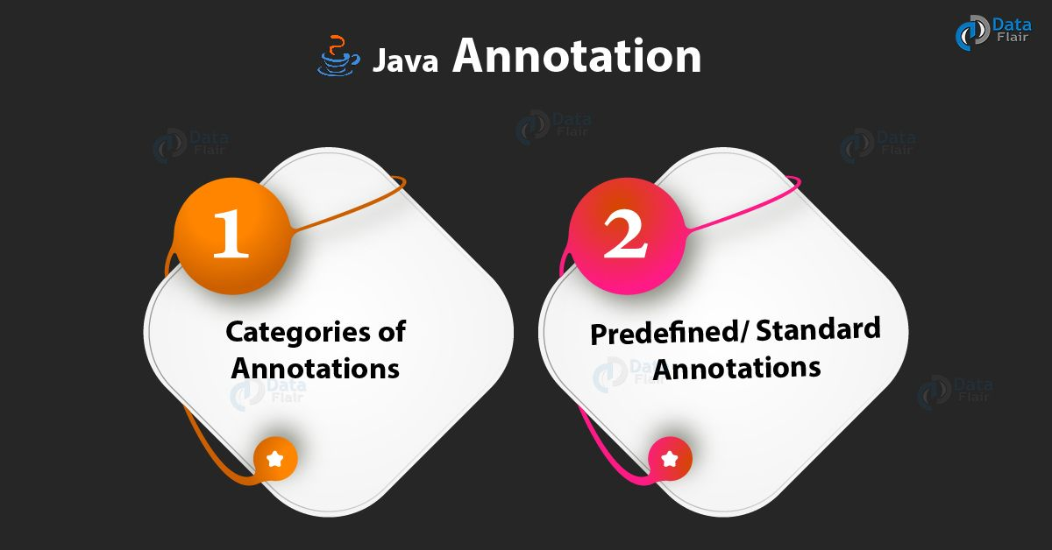
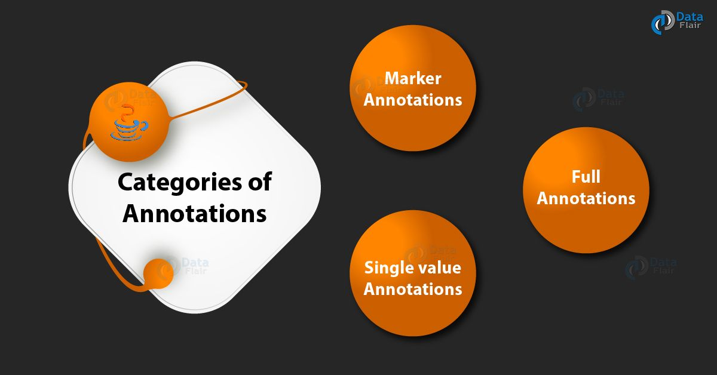
Annotations used in JUNIT

Slide 35
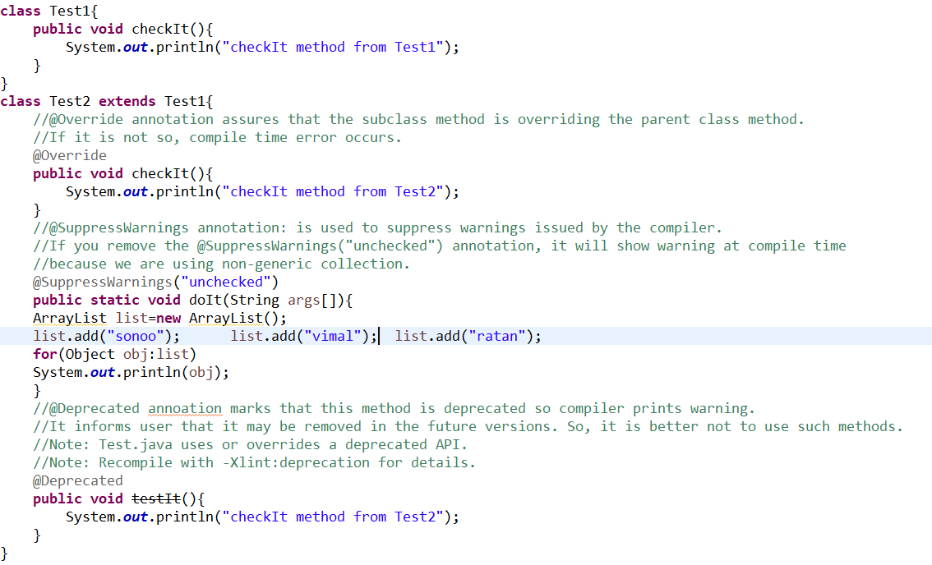
Annotations

Slide 36
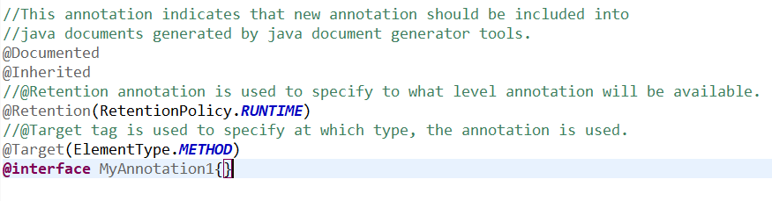
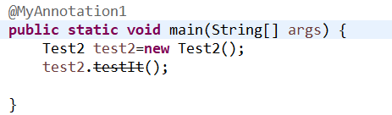
Annotations

Slide 37
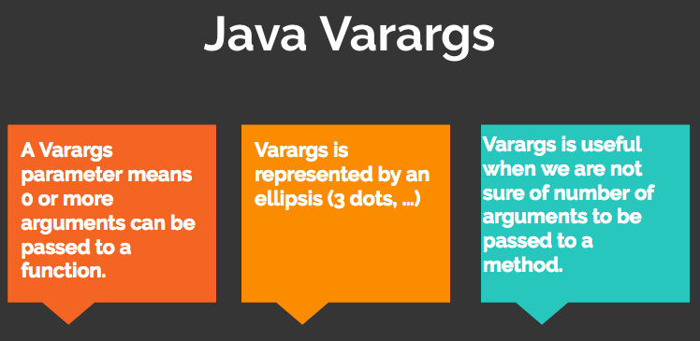
Java Varargs

Slide 38
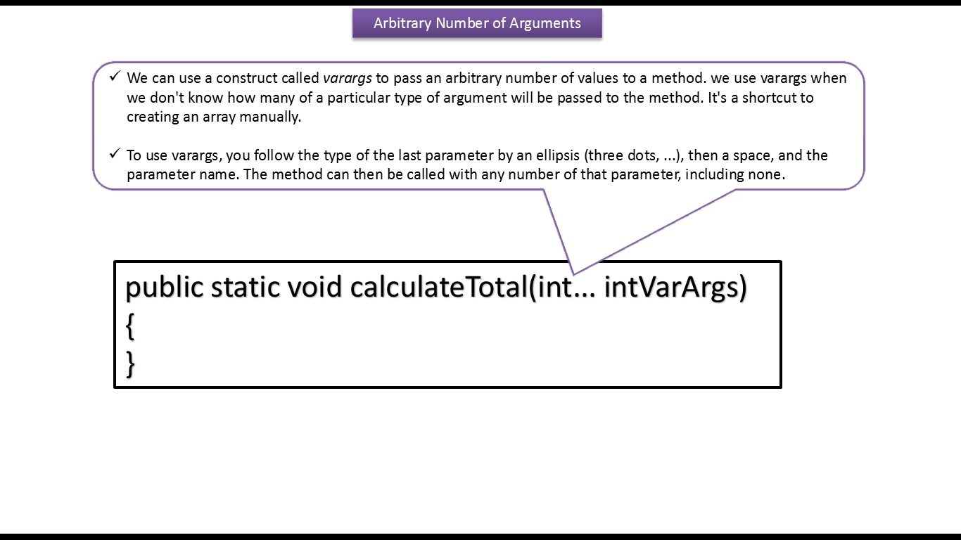
Java Varargs

Slide 39
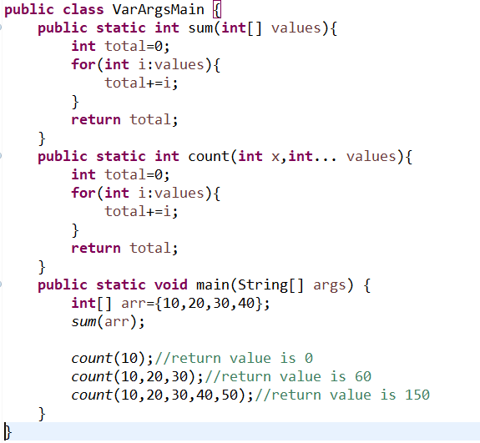
JAVA Varargs

Slide 40
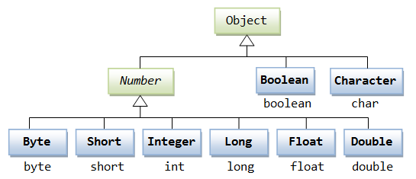
Wrapper Classes

Slide 41
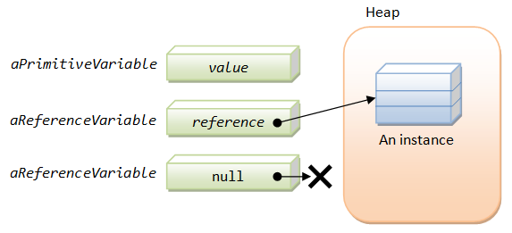
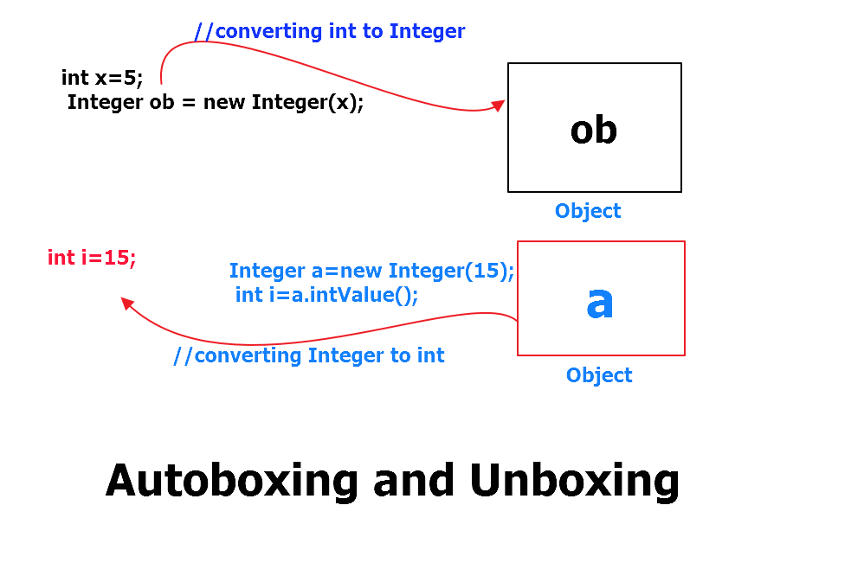
Boxing and Unboxing

Slide 42
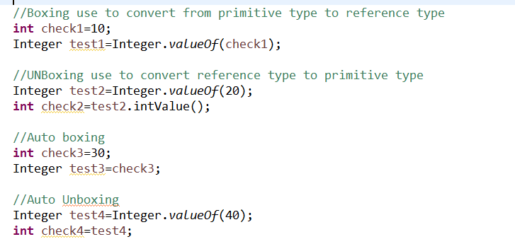
Boxing and Unboxing

Slide 43
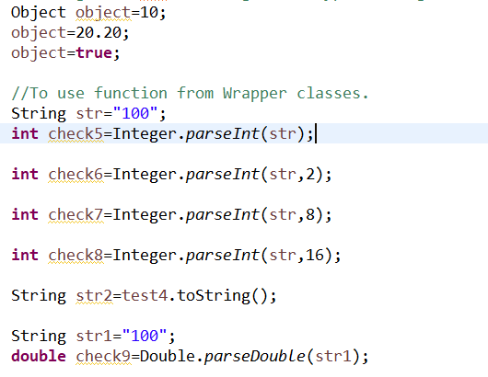
Use of Boxing and Unboxing

